Slide 1
Sales Performance Analysis of Walmart Stores Using Advanced MySQL Techniques.
SQL Project
Internshala
Priyansh Saini
15th November Batch

Slide 2
Introduction
Walmart, a major retail chain, operates across several cities, offering a wide range of products. The dataset provided contains detailed transaction data, including customer demographics, product lines, sales figures, and payment methods. This project will use advanced SQL techniques to uncover actionable insights into sales performance, customer behaviour, and operational efficiencies.
Problem Statement - Walmart wants to optimize its sales strategies by analyzing historical transaction data across branches ,customer types, payment methods, and product lines.
Dataset Link
March 30, 2025

Slide 3

Problem 1
SQL Query
WITH MonthlySales AS (
SELECT
Branch,
DATE_FORMAT(Date, '%Y-%m') AS Month,
SUM(Total) AS TotalSales
FROM walmartsales
GROUP BY Branch, Month
),
GrowthRate AS (
SELECT
Branch,
Month,
TotalSales,
LAG(TotalSales) OVER (PARTITION BY Branch ORDER BY Month) AS PrevMonthSales,
((TotalSales - LAG(TotalSales) OVER (PARTITION BY Branch ORDER BY Month)) /
LAG(TotalSales) OVER (PARTITION BY Branch ORDER BY Month)) * 100 AS GrowthRate
FROM MonthlySales
)
SELECT Branch, TotalSales FROM GrowthRate ORDER BY GrowthRate desc limit 1;
Task 1: Identifying the Top Branch by Sales Growth Rate
Walmart wants to identify which branch has exhibited the highest sales growth over time. Analyze the total sales
for each branch and compare the growth rate across months to find the top performer.
Result
Findings
Branch 'A' has exhibited the highest sales growth rate over time compared to other branches.
March 30, 2025

Slide 4

Problem 2
SQL Query
SELECT branch, `product line`, total_profit
FROM (
SELECT branch, `product line`,
SUM(`gross income` + cogs) AS total_profit,
RANK() OVER (PARTITION BY branch ORDER BY SUM(`gross income` - cogs) desc) AS rankvalue
FROM walmartsales
GROUP BY branch, `product line`
) ranked_data
WHERE rankvalue = 1;
Task 2: Finding the Most Profitable Product Line for Each Branch Walmart needs to determine which product line contributes the highest profit to each branch. The profit margin
should be calculated based on the difference between the gross income and cost of goods sold.
Result
Findings
Branch A's top performer, Health and Beauty, suggests strong demand for personal care products.
Branch B benefits the most from Food and Beverages, likely due to high turnover and frequent purchases.
Branch C's profitability is driven by Home and Lifestyle, indicating strong customer interest in household goods
March 30, 2025

Slide 5
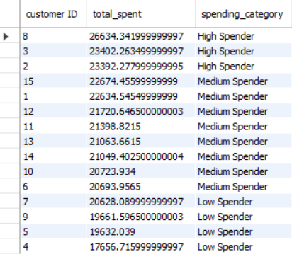
Problem 3
SQL Query
WITH customer_spending AS (
SELECT `customer ID`, SUM(total) AS total_spent
FROM walmartsales
GROUP BY `customer id`
),
ranked_customers AS (
SELECT `customer ID`, total_spent,
NTILE(4) OVER (ORDER BY total_spent) AS spending_quartile
FROM customer_spending
)
SELECT `customer ID`, total_spent,
CASE
WHEN spending_quartile = 4 THEN 'High Spender'
WHEN spending_quartile IN (2, 3) THEN 'Medium Spender'
ELSE 'Low Spender'
END AS spending_category
FROM ranked_customers
ORDER BY total_spent DESC;
Task 3: Analyzing Customer Segmentation Based on Spending
Walmart wants to segment customers based on their average spending behavior. Classify customers into three tiers: High, Medium, and Low spenders based on their total purchase amounts.
Result
Findings
High Spenders: Customers with the highest total spending, e.g., Customer 8 ($26,634.34), Customer 3 ($23,402.26), and Customer 2 ($23,392.28).
Medium Spenders: Customers in the mid-range, e.g., Customer 15 ($22,674.46) to Customer 6 ($20,693.96).
March 30, 2025

Slide 6
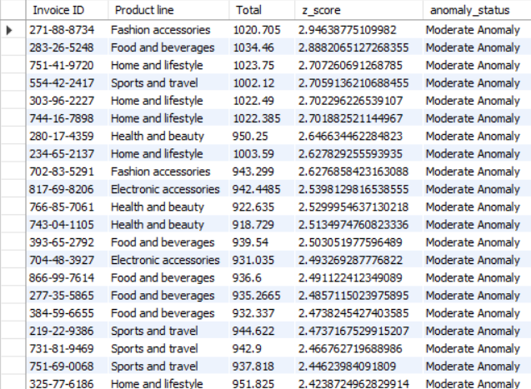
Problem 4
SQL Query
Task 4: Detecting Anomalies in Sales Transactions
Walmart suspects that some transactions have unusually high or low sales compared to the average for the product line. Identify these anomalies.
WITH product_sales_stats AS (
SELECT `Product line`, AVG(Total) AS avg_sales, STDDEV(Total) AS std_dev_sales
FROM walmartsales GROUP BY `Product line`
),
sales_anomalies AS (
SELECT w.`Invoice ID`, w.`Product line`, w.`Total`, p.avg_sales, p.std_dev_sales,
(w.`Total` - p.avg_sales) / p.std_dev_sales AS z_score
FROM walmartsales w JOIN product_sales_stats p ON w.`Product line` = p.`Product line`
)
SELECT `Invoice ID`, `Product line`, `Total`, z_score,
CASE WHEN ABS(z_score) > 3 THEN 'High Anomaly'
WHEN ABS(z_score) BETWEEN 2 AND 3 THEN 'Moderate Anomaly'
ELSE 'Normal' END AS anomaly_status
FROM sales_anomalies
WHERE ABS(z_score) > 2
ORDER BY ABS(z_score) DESC;
Result
March 30, 2025

Slide 7

Problem 5
SQL Query
WITH payment_counts AS (
SELECT
City,
Payment,
COUNT(*) AS payment_count,
RANK() OVER (PARTITION BY City ORDER BY COUNT(*) DESC) AS payment_rank
FROM walmartsales
GROUP BY City, Payment
)
SELECT
City,
Payment ,
payment_count
FROM payment_counts
WHERE payment_rank = 1;
Task 5: Most Popular Payment Method by City (6 Marks)
Walmart needs to determine the most popular payment method in each city to tailor marketing strategies.
Result
Findings
Mandalay: E-wallet is the most used payment method, with 113 transactions.
Naypyitaw: Cash is the most preferred payment method, with 124 transactions.
Yangon: E-wallet dominates as the most popular payment method, with 126 transactions.
March 30, 2025

Slide 8
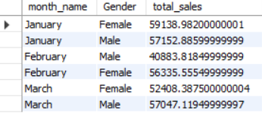
Problem 6
SQL Query
WITH payment_counts AS (
SELECT
City,
Payment,
COUNT(*) AS payment_count,
RANK() OVER (PARTITION BY City ORDER BY COUNT(*) DESC) AS payment_rank
FROM walmartsales
GROUP BY City, Payment
)
SELECT
City,
Payment ,
payment_count
FROM payment_counts
WHERE payment_rank = 1;
Task 6: Monthly Sales Distribution by Gender
Walmart wants to understand the sales distribution between male and female customers on a monthly basis.
Result
Findings
Female customers spent more in January and February, suggesting a stronger purchasing trend during these months.
Male customers led sales in March, indicating a shift in spending behavior.
February showed the largest gender-based spending gap, with female customers outspending males by over $15,000.
March 30, 2025

Slide 9

Problem 7
SQL Query
WITH product_sales AS (
SELECT
`Customer type`,
`Product line`,
SUM(Total) AS total_sales,
RANK() OVER (PARTITION BY `Customer type` ORDER BY SUM(Total) DESC) AS rank_order
FROM walmartsales
GROUP BY `Customer type`, `Product line`
)
SELECT
`Customer type`,
`Product line`,
total_sales
FROM product_sales
WHERE rank_order = 1;
Task 7: Best Product Line by Customer Type
Walmart wants to know which product lines are preferred by different customer types(Member vs. Normal).
Result
Findings
Members prefer: Food & Beverages ($31,357.62) → Focus on meal deals & loyalty rewards.
Normal customers prefer: Electronic Accessories ($29,839.04) → Push tech discounts & bundling offers.
March 30, 2025

Slide 10
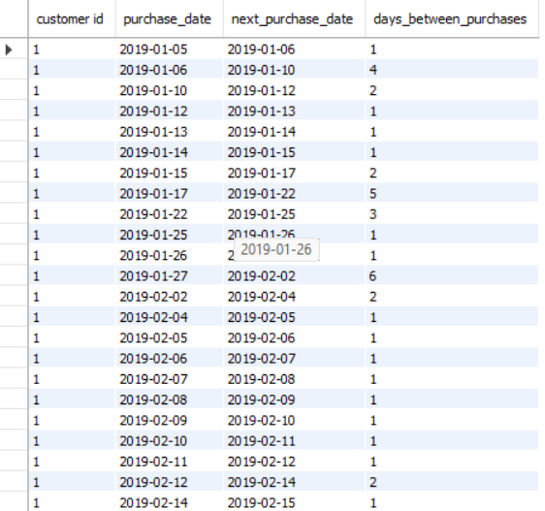
Problem 8
SQL Query
WITH CustomerPurchases AS (
SELECT
`customer id`,
STR_TO_DATE(Date, '%d-%m-%Y') AS purchase_date
FROM walmartsales GROUP BY `customer id`, STR_TO_DATE(Date, '%d-%m-%Y')
),
PurchaseSequence AS (
SELECT
`customer id`,
purchase_date,
LEAD(purchase_date) OVER (PARTITION BY `customer id` ORDER BY purchase_date) AS next_purchase_date
FROM CustomerPurchases
)
SELECT
`customer id`,
purchase_date,
next_purchase_date,
DATEDIFF(next_purchase_date, purchase_date) AS days_between_purchases
FROM PurchaseSequence
WHERE
next_purchase_date IS NOT NULL
AND DATEDIFF(next_purchase_date, purchase_date) <= 30;
Task 8: Identifying Repeat Customers
Walmart needs to identify customers who made repeat purchases within a specific time frame (e.g., within 30 days).
Result
March 30, 2025

Slide 11
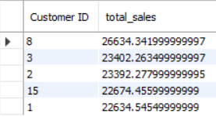
Problem 9
SQL Query
SELECT
`Customer ID`,
SUM(Total) AS total_sales
FROM walmartsales
GROUP BY `Customer ID`
ORDER BY total_sales DESC
LIMIT 5;
Task 9: Finding Top 5 Customers by Sales Volume
Walmart wants to reward its top 5 customers who have generated the most sales Revenue.
Result
Findings
Customer ID 8,3,2,15 and 1 are the customers which Walmart should focus on to generate more sales.
March 30, 2025

Slide 12
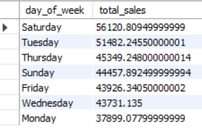
Problem 10
SQL Query
SELECT
DAYNAME(STR_TO_DATE(Date, '%d-%m-%Y')) AS day_of_week,
SUM(Total) AS total_sales
FROM walmartsales
GROUP BY day_of_week
ORDER BY total_sales DESC;
Task 10: Analyzing Sales Trends by Day of the Week
Walmart wants to analyze the sales patterns to determine which day of the week brings the highest sales.
Result
Findings
Saturday and Tuesday are the days which have maximum amount of sales.
March 30, 2025

Slide 13
Video Explanation
Here is the Video explanation for this project – Video Link
March 30, 2025

Slide 14
Thank You
March 30, 2025

